Slide 1

Photo Points: North Creek Forest

Slide 2
Photo Points: MVP
The Minimum Viable Product will allow the administrator to view approved photos, search photos, view pending photos from the mobile application.

Slide 3
Photo Points: User Stories
Administrator wants to view approved photo stream
Administrator wants to view pending submissions
Administrator wants to search submissions

Slide 4
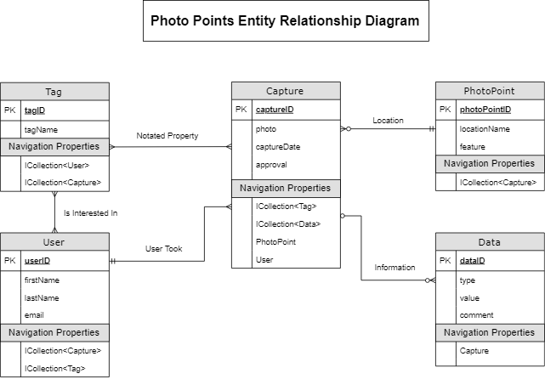
Photo Points: Model ERD

Slide 5
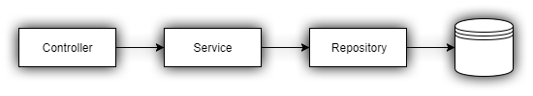
Photo Points: Admin Review Service/Repository
Design pattern
Dependency injection
Domain logic and data access logic
Notes:
A user sends an HTTP request to the server.
Asp.Net MVC route the request to a Controller action.
The action’s responsibility is to handle the request and the response, nothing more.
Since the domain logic is not of the controller responsibility, it must be delegated to another object. That object is the Service.
While the Service owns the domain logic responsibility, it cannot take another one so it cannot handle the data access logic. It must delegate that to the Repository.
The Repository, as already stated, is responsible for the data-access. Basically, it read/write data from/to a data-source.

Slide 6
Admin Approval Service Test
Testing method works and pass for Admin Review Service
Fake Admin repository
Use a byte array for updating photo data to load and store the images into capture repository
Created Save changes method to compare properties in fake repository to be able to save and replace new information in the capture repository
Support for Macs
Mac user can assign use the database without adding or changing any code

Slide 7
UI

Slide 8
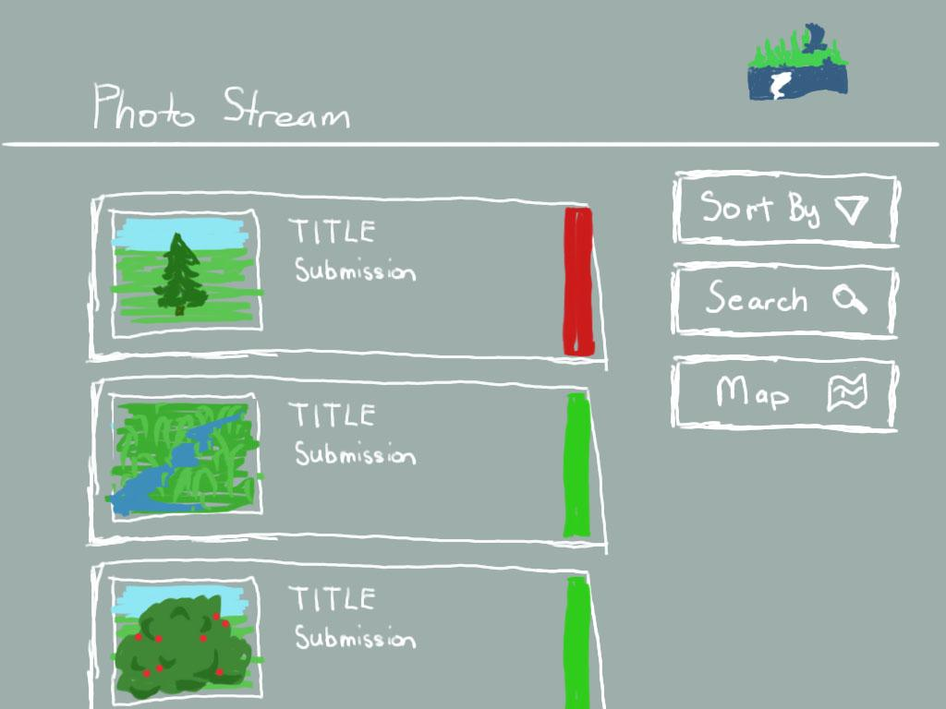
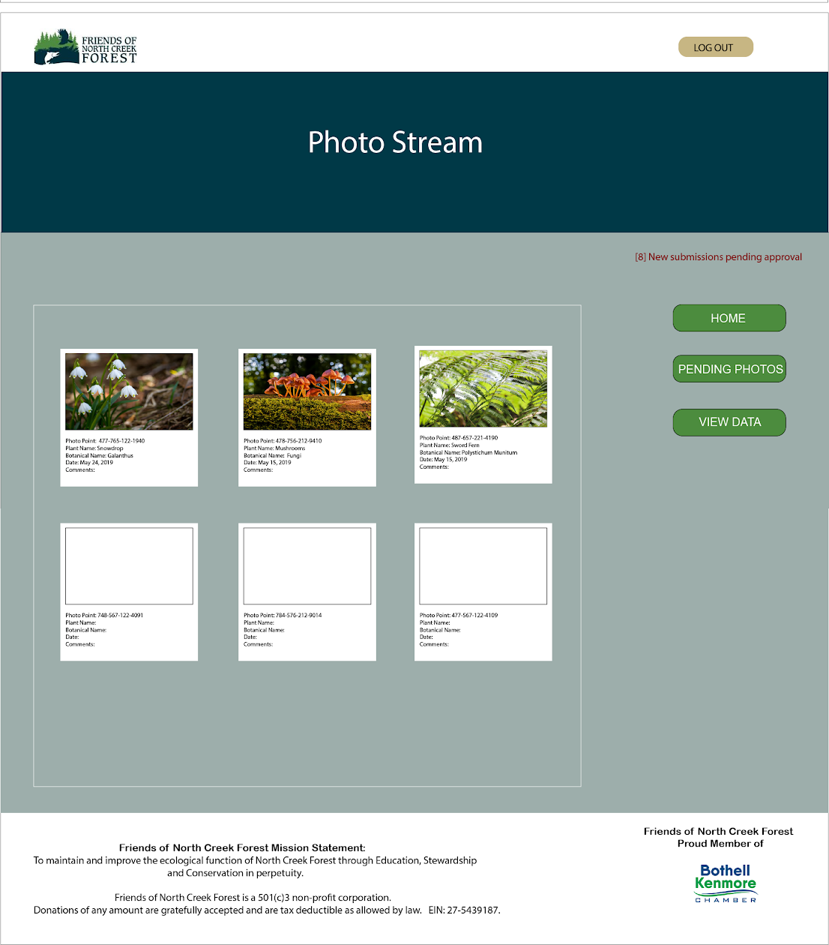
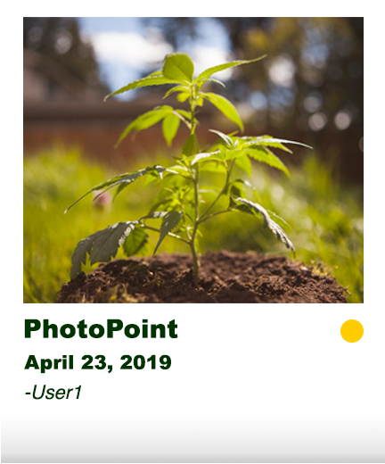
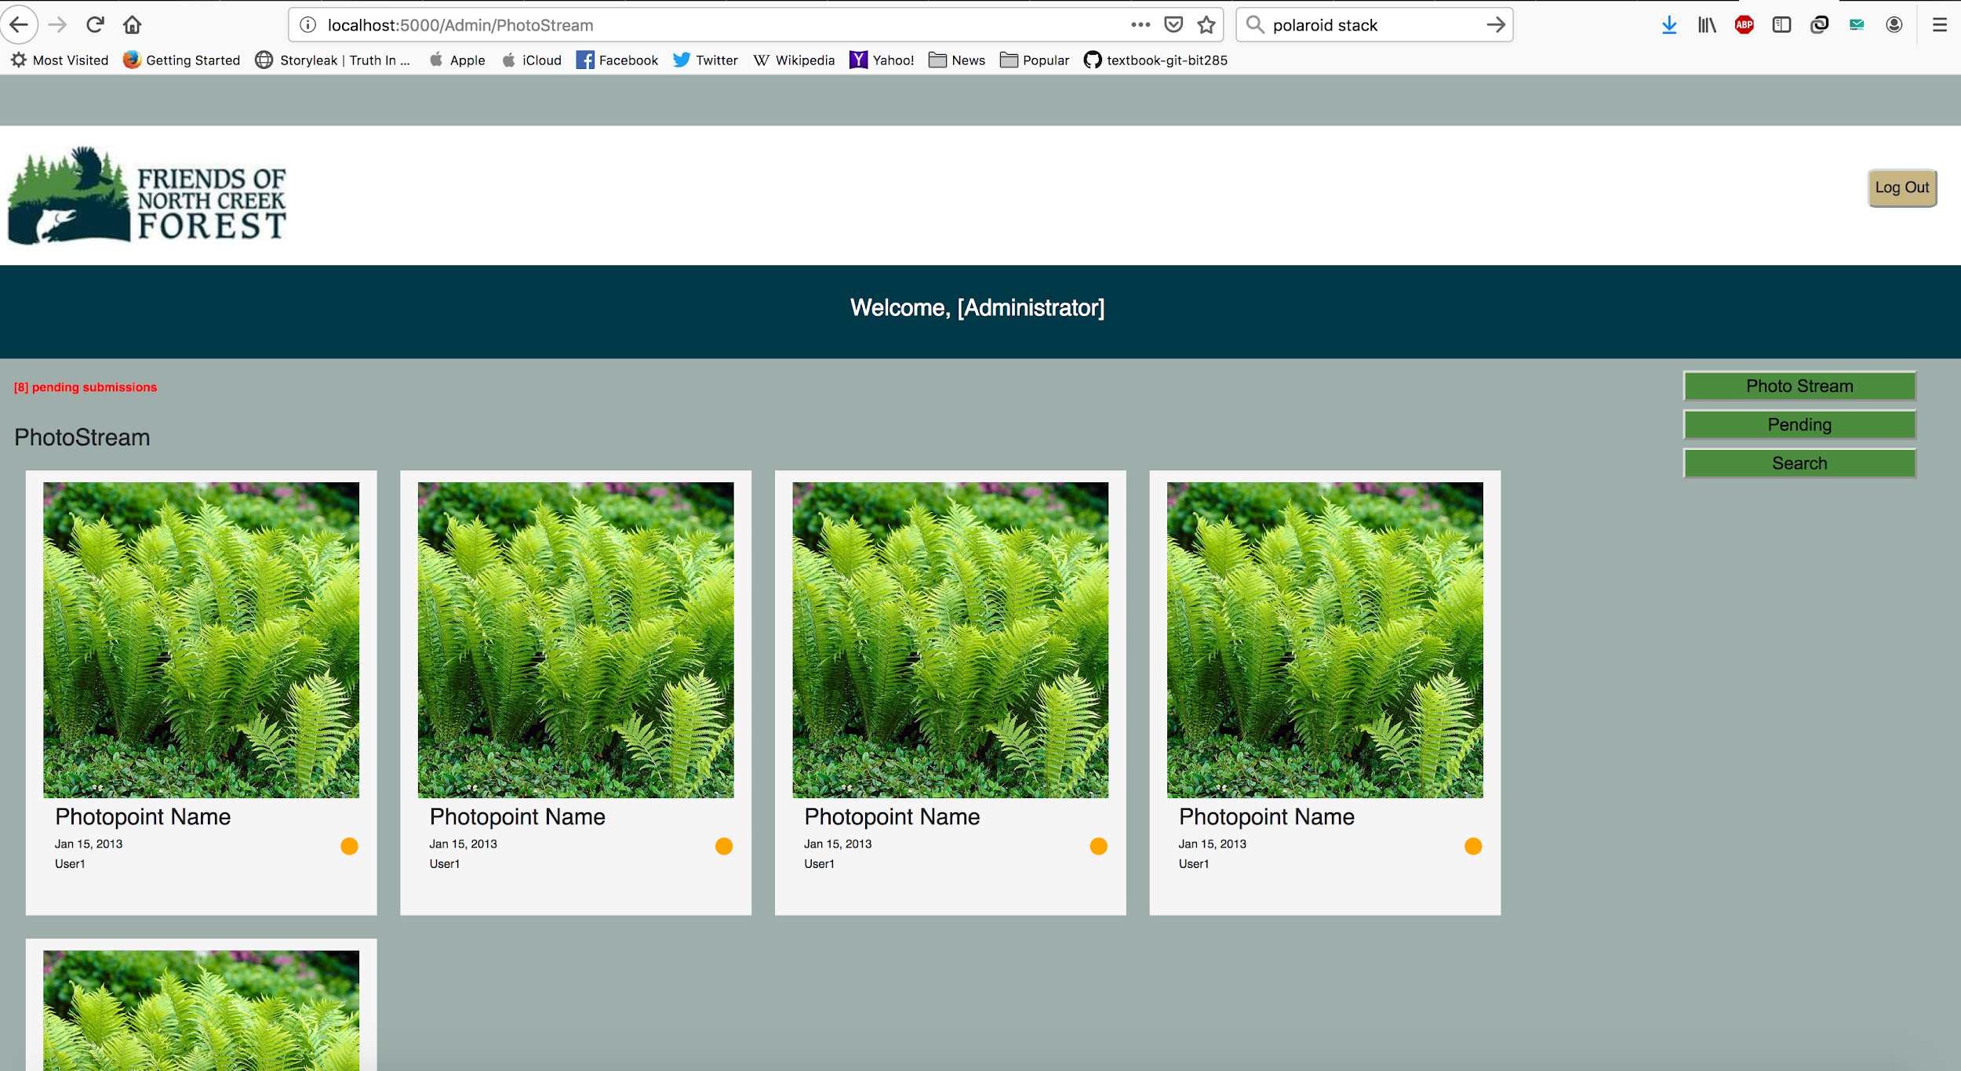

Slide 9

The influence

Slide 10
Demonstration of our Application

Slide 11
Photo Points: User Stories Accomplished
Administrator is able to see pending images
Administrator is able to access search page
Administrator is able to view the approved photo stream

Slide 12
Photo Points: MVP Accomplished
Administrator can navigate to pending photos
Administrator can view pending images in repository
User interface to search repository
Backend services to approve and deny user submissions
Solid Entity Model

Slide 13
Photo Points: Next Steps in Development
Create controllers to connect database with view
Add functionality to tag photos
Add functionality to add notes to photos
Add functionality for tag-associated notifications to collaborators
User interface controllers to approve and reject pending submissions

Slide 14
Thank You

